Slide 1
Comprehensive Digital Marketing Project Work On Hero MotoCorp Ltd
Team Details
K J JOSEPH JERIN (TEAM LEADER)
ASHWINI KUMAR (TEAM MEMBER)
N. HARIKRISHNA (TEAM MEMBER)
KANCHU PARDHA SARADHI (TEAM MEMBER)
KOMMU SHIVA TEJA (TEAM MEMBER)
SOMAYAJULA SURYA NARAYANA (TEAM MEMBER)

Slide 2
Comprehensive Digital Marketing Project Work On Hero MotoCorp Ltd
Team Members
Acknowledgement
I am K J JOSEPH JERIN, as a Team Leader I have done these following Work in this Project
1. Power Point Presentation
2. Brand study,
3. Competitor Analysis
4. Buyers Audience Persona
5. Instagram Post and Instagram Story

Slide 3
Comprehensive Digital Marketing Project Work On Hero MotoCorp Ltd
Team Members
Acknowledgement
I am ASHWINI KUMAR, as a Team Member I have done these following Work in this Project
1. Buyers Audience Persona

Slide 4
Comprehensive Digital Marketing Project Work On Hero MotoCorp Ltd
Team Members
Acknowledgement
I am N. HARIKRISHNA, as a Team Member I have done these following Work in this Project
1. SEO
2. SEO Audit
3. Keyword Research

Slide 5
Comprehensive Digital Marketing Project Work On Hero MotoCorp Ltd
Team Members
Acknowledgement
I am KANCHU PARDHA SARADHI , as a Team Member I have done these following Work in this Project
Content Ideas
More About Maintenance

Slide 6
Comprehensive Digital Marketing Project Work On Hero MotoCorp Ltd
Team Members
Acknowledgement
I am KOMMU SHIVA TEJA, as a Team Member I have done these following Work in this Project
1. Marketing Strategy

Slide 7
Comprehensive Digital Marketing Project Work On Hero MotoCorp Ltd
Team Members
Acknowledgement
I am SOMAYAJULA SURYA NARAYANA , as a Team Member I have done these following Work in this Project
Content Creation
Content Curation

Slide 8

About Our Project
Company / Topic for project:
HERO MOTOCORP LTD
Research Brand Identity:
Brand logo:
Brand colours : Red and Black
Brand tagline : “Hum Main Hai Hero”.
Brand’s website : https://www.heromotocorp.com/

Slide 9

Brand Study Of Hero MotoCorp Ltd
About the Logo Of Hero MotoCorp Ltd :-
The Hero logo is a celebration of the Brand's progress and innovative approach.
It is a great symbol of a powerful company with a bright future and values of its heritage.
The Icon is the modern abstract representation of the letter H.

Slide 10
Brand Study Of Hero MotoCorp Ltd
About the Logo Of Hero MotoCorp Ltd :-
The Icon Communicates a sense of Engineering and Intelligence. The Red Colour in the Logo Shows the Continuity, Change and also Confidence.
The Red Colour in the Logo’s Symbol Shows the Indication of Fuel or Fuel Level
The Black Colour indicates the type of powerful Engine used and the Experienced Mechanic they use.
The Logo is Geometrical and Sharper.

Slide 11
Brand Study Of Hero MotoCorp Ltd
About the Mission Of Hero MotoCorp Ltd :
HMC group of Companies aspires to deliver the best and the most cost-effective products & solutions empowered by superior technologies.
The Group is committed to ensuring value for money by developing high-quality, environment-friendly and efficient solutions that fulfil the diverse needs of customers.
At Hero Motors, we are committed to give our best and Achieve the Highest Standards in Performance, Quality, Systems, Care and Relationships. And then we want to beat these High Standards and go further because anything that can be done can be done better.”

Slide 12
Brand Study Of Hero MotoCorp Ltd
About the Vision Of Hero MotoCorp Ltd :
HMC group of Companies aspires to deliver the best and the most cost-effective products & solutions empowered by superior technologies.
Re-define Mobility through the creation of a Mobility Roadmaps
Set best practice and Benchmarks for the Industry.

Slide 13
Brand Study Of Hero MotoCorp Ltd
About the Advertising Slogan Of Hero MotoCorp Ltd :
Hero MotoCorp released a Nationwide Campaign in August 2011 Unveiling its new corporate Identity with the Slogan - Hum Mein Hai Hero.
The Popular Advertising Campaign Based on the Slogan 'Fill it – Shut it – Forget it' that Emphasized the Motorcycle Fuel Efficiency and helped the Company grow at a Double- Digit pace since its Inception.
The Mileage and Fuel Evaluation of each Vehicle Produced were following the Slogan made by the Company Chairman

Slide 14
Competitor Analysis of Hero MotoCorp Ltd
About the Other Competitors With Hero MotoCorp Ltd :-
Hero MotoCorp Has Many Competitors Across India they are as follows :
Jawa Motorcycles
Honda Motorcycle and Scooter India
TVS Motor Company
Mahindra Two Wheelers
Ampere Vehicles and Ola Electric
Bajaj Auto
Royal Enfield

Slide 15
Target Audience
Target Audience :
Hero MotoCorp is Targeting Audience Mainly Through :
Young boys looking for fast Sporty Bikes for Indian Roads.
Young boys in the Age Between 19 – 30 years old.
Hero Moto Corp gives a bike to every person who has a hero and a winner within one's self

Slide 16
Buyers Persona
Buyers Persona :
Buyers are Looking For a Vehicle For Transportation , With these important segments :
Less Cost
Less Consumption of Fuel
More Mileage
A Joyful Ride
Transportation To Workplace to Home
Good Quality and Strong Body Parts
Spare Parts Availability

Slide 17
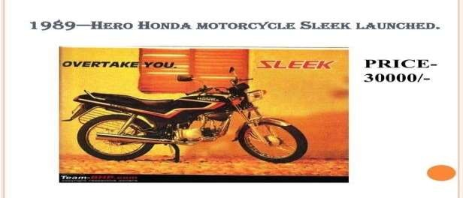
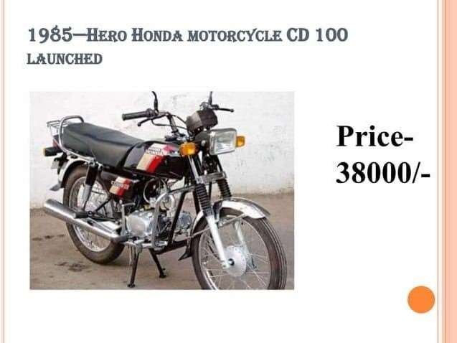
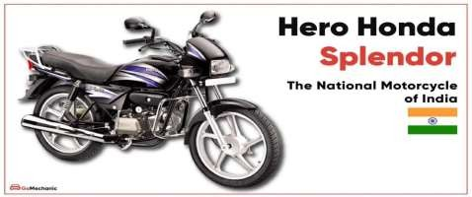

Models of Bikes

Slide 18
SEO
Analyzing SEO of Hero MotoCorp :
Search Engine Optimization As per Uber suggest Data, it Ranks in India for 127,869 keywords as of September 2023.
Its organic traffic is 3,233,074 sessions per month.
The stats are high compared to their SEO performance in June 2023
heromotocorp.com – Uber suggest Traffic Analyzer Backlinksheromotocorp.com – Uber suggest Backlinks Hero MotoCorp gets backlinks from 639,634 unique domains, increasing the Domain Authority of Hero’s domain and helping it rank higher.

Slide 19
SEO
Backlinks and Referring Domains:
Uncover the referring domains of your competition, assess their backlink profile expansion, and get a clear picture of the opportunities you may be missing.
In August the number of backlinks to heromotocorp.com has dropped by -1.8% and equals 214.7K. The amount of referring domains has increased by 2.7% and equals 7.9K.

Slide 20
SEO Audit
Report on the Audit of the Standalone :
Financial Statements
Opinion
We have audited the standalone financial statements of
Hero MotoCorp Limited (“the Company”), which comprise
The Standalone Balance Sheet as at March 31, 2022, and the Standalone Statement of Profit and Loss
(Including Other Comprehensive Income), the Standalone Statement of Changes

Slide 21
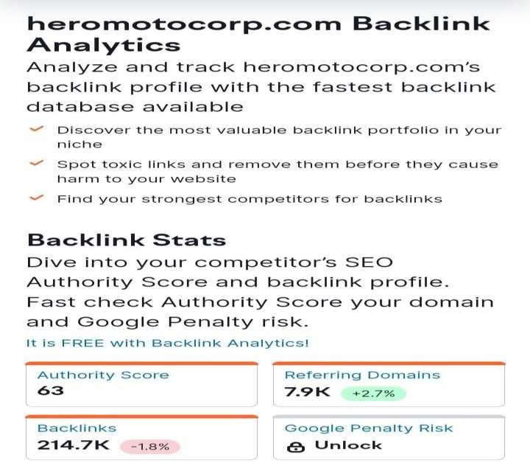
SEO

Slide 22
Keywords Research
OBJECTIVES FOR KEYWORD RESEARCH :
TO INCREASE WEBSITE TRAFFIC:
As keyword research helps us know which key words are used by target
customer mostly, by this we can improve our website traffic.
TO IMPROVE ORGANIC SEARCH RANKING:
By Keyword Research we can know which key words are performing best, which high search volume and lower competition, so that we can optimize our website with those key words to improve organic search ranking.
TO REACH OUT MORE AUDIENCE:
Keyword research helps us find out which keys are god to target out prospective customers and so that we can use those keywords in our website's content.

Slide 23
Keywords Research
KEY INSIGHTS :
1. Targeted content creation: Keyword research helps identify the topics and questions that your target audience is searching for. By incorporating these keywords into your content strategy, you can create valuable, relevant content that meets the needs of your audience.
2. Enhanced user experience: Understanding user search intent through keyword research allows you to align your content with what users are looking for. This improves the overall user experience on your website, leading to increased engagement, longer visit durations, and lower bounce rates.
3.Competitive Advantage: By focusing on these untapped keywords, you can gain a competitive advantage and attract targeted traffic that your competitors are missing out on.

Slide 24
Keywords Research
OBJECTIVES FOR KEYWORD RESEARCH :
TO INCREASE WEBSITE TRAFFIC :
As keyword research helps us know which key words are used by
target customer mostly, by this we can improve our website traffic.
TO IMPROVE ORGANIC SEARCH RANKING :
By keyword research we can know which key words are performing best, which high search volume and lower competition, so that we can optimize our website with those key words to improve organic search ranking.
TO REACH OUT MORE AUDIENCE :
Keyword research helps us find out which keys are god to target out
prospective customers and so that we can use those keywords in our website's content.

Slide 25
Keywords Research
CHALLENGES FACED DURING KEYWORD RESEARCH AND ANALYSIS :
Limited data accuracy :
Keyword research tools provide estimates and data based on historical trends. It's essential to consider this potential limitation when conducting keyword analysis.
Highly competitive keywords :
Some keywords may have high search volume but also intense competition. Ranking for such keywords can be challenging, especially if your website or content is relatively new.

Slide 26
Keywords Research
PROCESS OF CONDUCTING KEYWORD RESEARCH:
Limited Data Accuracy:
Keyword research tools provide estimates and data based on historical trends. It's essential to consider this potential limitation when conducting keyword analysis.
Highly Competitive Keywords:
Some keywords may have high search volume but also intense competition. Ranking for such keywords can be challenging, especially if your website or content is relatively new.

Slide 27
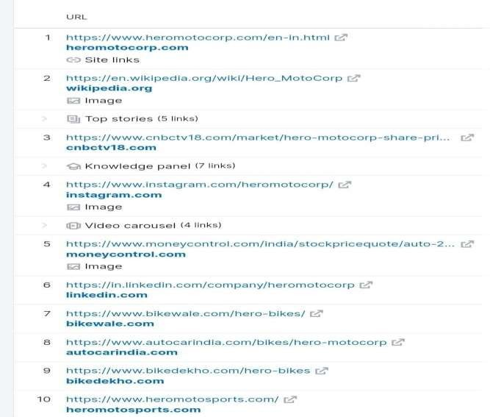
Keywords Research

Slide 28
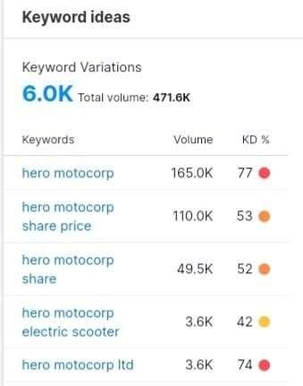
Keywords Ideas

Slide 29
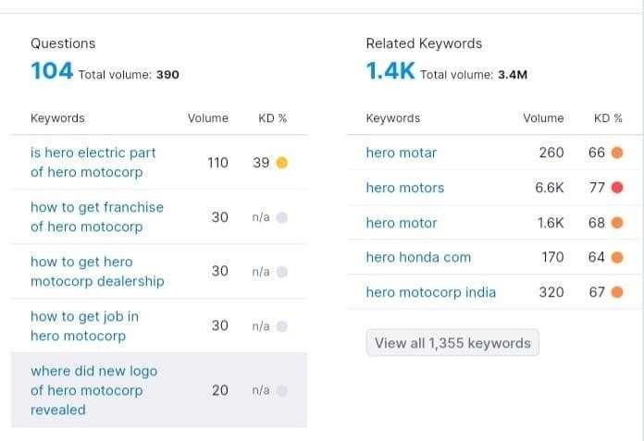
Keywords Ideas

Slide 30
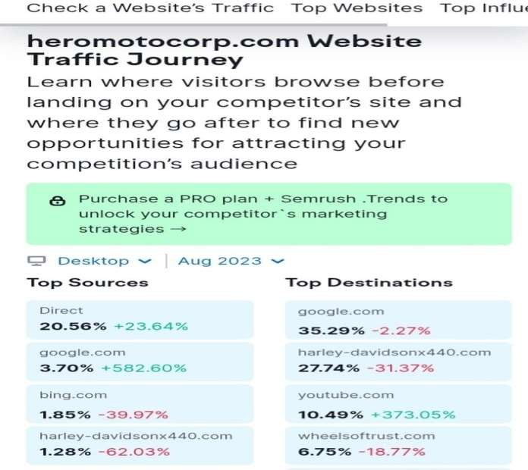
Website Traffic or On Page Optimization

Slide 31
Content Ideas
The Importance of Motorcycle Maintenance :
Replacing worn-out parts and addressing minor issues before they escalate, you can keep your Bike Running Smoothly for years to come.
This not only saves you money in the long run, but it also allows you to develop a deeper connection with your machine.

Slide 32
Content Ideas
Basic Motorcycle Maintenance Tasks :
Inspect the brakes.
Check the brake pads for wear and tear, and ensure that the brake fluid is at the correct level.
If you notice any issues, such as squeaking or reduced braking performance, it's crucial to address them promptly.

Slide 33
Content Ideas
Essential Tools for Motorcycle Maintenance :
Having the Right Tools is Essential for Effective Motorcycle Maintenance.
While the Specific Tools you'll need may vary depending on your Bike’s Make and Model, there are a few basic tools that every motorcycle owner should have in their Toolbox.
Invest in a Good Quality set of Metric Wrenches and sockets.
These will come in Handy for various Maintenance tasks including removing and tightening Bolts and Nuts.

Slide 34
Content Ideas
Motorcycle Maintenance Checklist :
Replace the Air filter if Necessary.
Test and Replace Spark Plugs if Needed.
Check the Battery and Clean the Terminals.
Inspect and Tighten all Bolts and Nuts.
Clean and polish the motorcycle for a fresh look.
Inspect suspension components for wear and damage
Check and Adjust Clutch and Throttle Cables.

Slide 35
Content Ideas
Equal Opportunity Employer :
Hero MotoCorp is proud to be an Equal Employment Opportunity Employer who will always be committed towards creating a truly inclusive workplace with a culture that values, respects and encourages Diversity.
Hero provides Equal Opportunity to all its workforce irrespective of race, color, sex, religion, sexual orientation, national origin, disability, genetic information, pregnancy, or any other protected characteristic as outlined by federal, state, or local laws.

Slide 36
Content Ideas
Perks of being a Hero Employee :
At Hero, we Define our culture as caring and performance oriented.
We’re passionate about Creating Enthusiastic Customers and Building a Better Future, but we are committed to doing so with our team members’ best interests in mind – providing a family-oriented, open and collaborate environment where all can succeed
Many Employee friendly policies like Insurance Policies, Financial Assistance Policies, Rewards & Recognition Policies, Employee Wellbeing Policies, Development Programme, Diversity & Inclusion Initiatives

Slide 37
Content Ideas
Community Driven content of Hero MotoCorp:
Hero MotoCorp “We Care CSR initiative is all about “Caring for Humanity” and we believing in living up to that at every step.
We regularly undertake meaningful initiatives which helps in enriching the lives of marginalized community in meeting their current needs and also prepare the future generation to meet their needs in future by running sustainable programs.
We have touched almost 2,00,000 + people in various walks of life across India. Some of the programs include

Slide 38
Content Ideas
Project Community Engagement :
With a Development Approach, Team Hero befriends an entire village community under this project and assists in all possible ways to make them self-reliant, improve their wages, and fulfil their dream of becoming Entrepreneurs.
Some of the Engagement Activities that we carry out with our Active Non-Profit partners in the Hinterlands include engaging with women and skilling them in Tie-and-Dye techniques, Detergent making, Tailoring, sanitary napkin making, Beautician courses, etc. – a skillful task that can add to their regular earnings.

Slide 39
Content Ideas
Guest Blogging of Hero MotoCorp:
When Hero MotoCorp launched, it aimed to be the best two-wheeler manufacturer in India. It had a wide range of motorcycles and scooters, from affordable commuter bikes to high-performance motorcycles.
Over the years, Hero MotoCorp has expanded its global footprint and now exports its products to over 40 countries.
It is also investing heavily in electric vehicles, and has launched its first electric scooter, the Vida V1, in 2023.

Slide 40
Content Ideas
IIDE Logo :
Hero MotoCorp is an Indian multinational motorcycle and scooter manufacturer headquartered in New Delhi.
It is the world’s largest two-wheeler manufacturer and has a market share of about 46% in the Indian two-wheeler industry.
What did Hero MotoCorp do to possess a strong presence in the Global Market? We think Hero MotoCorp's Marketing Strategy played a significant part in all this.

Slide 41
Marketing Strategy
Hero MotoCorp Marketing Strategies :
Hero MotoCorp’s Marketing Strategy is focused on its core values of Trust, Reliability, and Innovation. The company also Emphasizes its commitment to making of mobility accessible to everyone.
1. Search Engine Optimization As per Uber suggest data, it ranks in India for 127,869 keywords as of September 2023. Its organic traffic is 3,233,074 sessions per month. The stats are high compared to their SEO performance in June 2023. heromotocorp.com - Uber suggest Traffic Analyzer Backlinksheromotocorp.com - Uber suggest Backlinks Hero MotoCorp gets backlinks from 639,634 unique domains,
increasing the Domain Authority of Hero’s domain and
helping it rank higher.

Slide 42
Marketing Strategy
Hero MotoCorp Marketing Strategies :
For example: On Instagram and Facebook, Hero MotoCorp often posts Photos and Videos of their Motorcycles in action, as well as Lifestyle Photos and Videos of People Enjoying their Bikes.
2. Strong Brand Identity :
Hero MotoCorp has a strong brand identity that is reflected in their social media presence. Their branding is consistent across all of their platforms, and they use a variety of visual elements to create a cohesive look. For example: Hero MotoCorp uses high- quality photos and videos to showcase their products and brand
•

Slide 43
Marketing Strategy
Hero MotoCorp Marketing Strategies :
Influencer Marketing :
Influencer marketing is a type of marketing that involves partnering with social media influencers to promote products or services.
As mentioned above Hero MotoCorp has Partnered with social media influencers mostly on Instagram to promote its products to their followers.

Slide 44
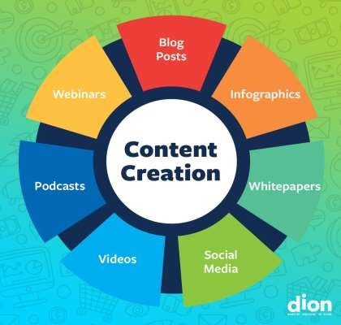
Content Creation
Podcast: Inside Hero Motocorp’s
"The Ride with Hero MotoCorp": A podcast
where they interview motorcycle enthusiasts, share their riding experiences,
and discuss the latest Hero MotoCorp models.
2. "Revving with Hero MotoCorp": A podcast
series that dives into the technical aspects of
Hero MotoCorp motorcycles, featuring discussions on engine performance, design, and innovation.
3. "Adventures on Two Wheels": Hero
MotoCorp presents exciting stories of riders who
have embarked on thrilling journeys,
exploring different terrains and sharing
their experiences.Remember, these are just examples, but they give you an idea of how Hero MotoCorp could use podcasts to
engage with their audience. 🎧

Slide 45
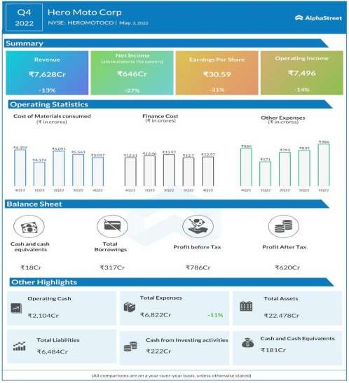
Content Creation
Infographic: Hero Moto Corp. Q4 2022 earnings
Infographics are visual representations, like charts or diagrams, used to convey information about Hero MotoCorp in a clear and engaging way. 📊

Slide 46
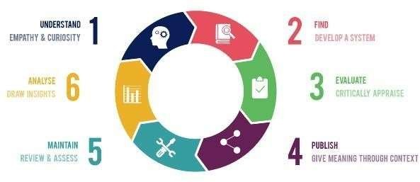
Content Creation & Curation
EMPATHY AND CURIOSITY :-
"Rider's Tales of Kindness": A collection of heartwarming stories shared by riders, highlighting instances where Hero MotoCorp owners have shown empathy and kindness towards others on the road or in their communities.
"Exploring the Unknown": A series that showcases adventurers and riders who have embarked on unique journeys, exploring lesser- known destinations and sharing their curious discoveries along the way.
"Innovations in Motion": Curating content that highlights Hero MotoCorp's innovative initiatives, such as eco-friendly technologies or community- driven projects, that demonstrate their curiosity to push boundaries and make a positive impact.By curating content around empathy and curiosity, Hero MotoCorp can inspire their audience, foster a sense of connection, and showcase their commitment to making a difference.

Slide 47
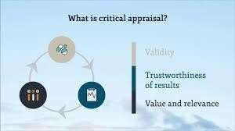
Content Creation & Curation
EVALUATION OF CRITICAL APPRAISE OF HERO MOTOCORP :-
1. Product Quality: Hero MotoCorp is known for manufacturing motorcycles that are reliable, durable, and offer good performance. Their bikes are built to withstand various road conditions, providing a smooth and enjoyable riding experience
2. Customer Satisfaction: Many riders express satisfaction with their Hero MotoCorp motorcycles, praising the brand for its affordability, fuel efficiency, and low maintenance costs. Hero MotoCorp has a strong customer support system in place, ensuring that riders' concerns are addressed promptly.
3. Innovation: Hero MotoCorp has been actively involved in developing and implementing innovative technologies in their motorcycles. For instance, they have introduced features like advanced fuel injection systems, integrated braking systems, and smart connectivity options to enhance the overall riding experience.
4. Market Performance: Hero MotoCorp has consistently maintained a significant market share in the motorcycle industry, both in India and globally. Their wide range of models caters to various segments and has helped them establish a strong presence in different markets.

Slide 48
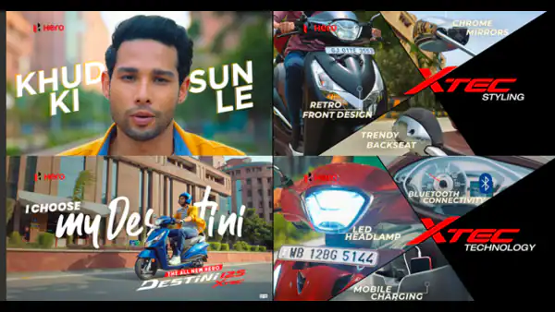
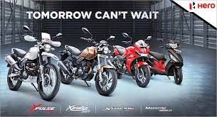
Content Creation & Curation
SOCIAL MEDIA AD CAMPAIGNS :

Slide 49
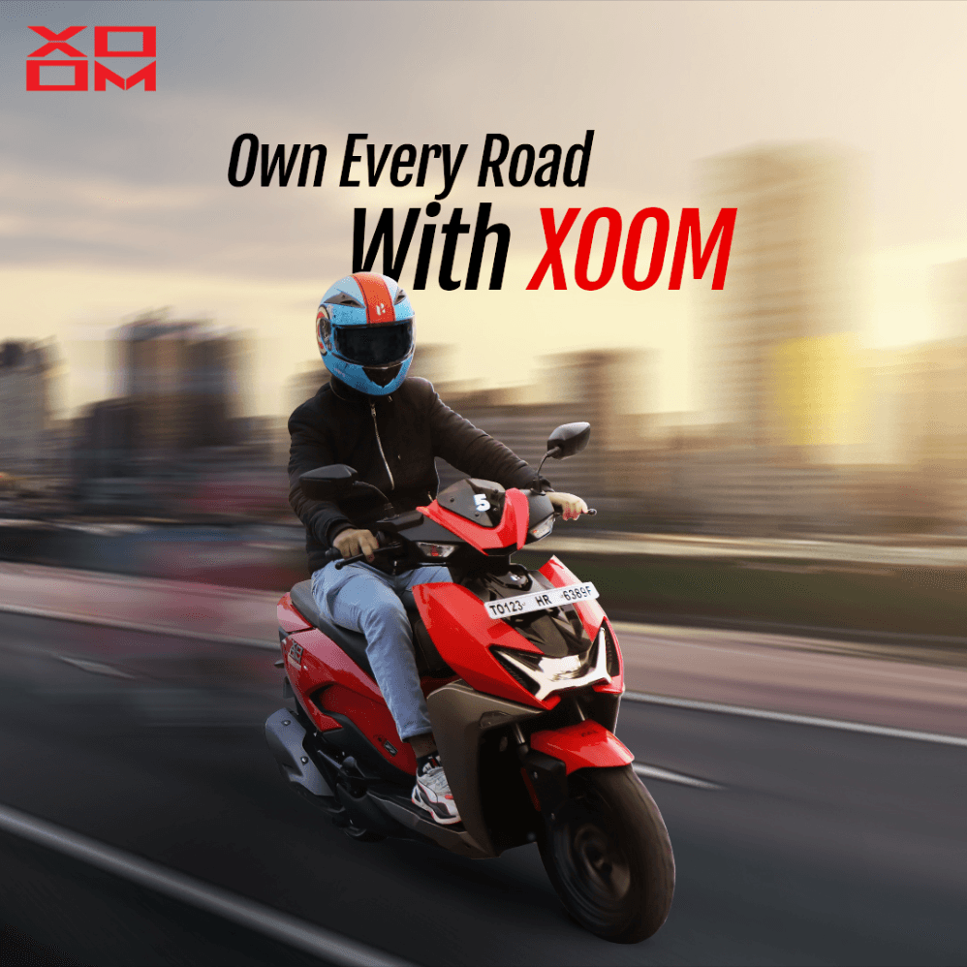
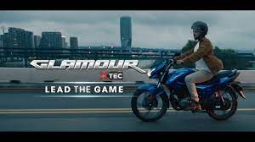
Content Creation & Curation
SOCIAL MEDIA AD CAMPAIGNS :

Slide 50


Content Creation & Curation
SOCIAL MEDIA AD CAMPAIGNS :

Slide 51

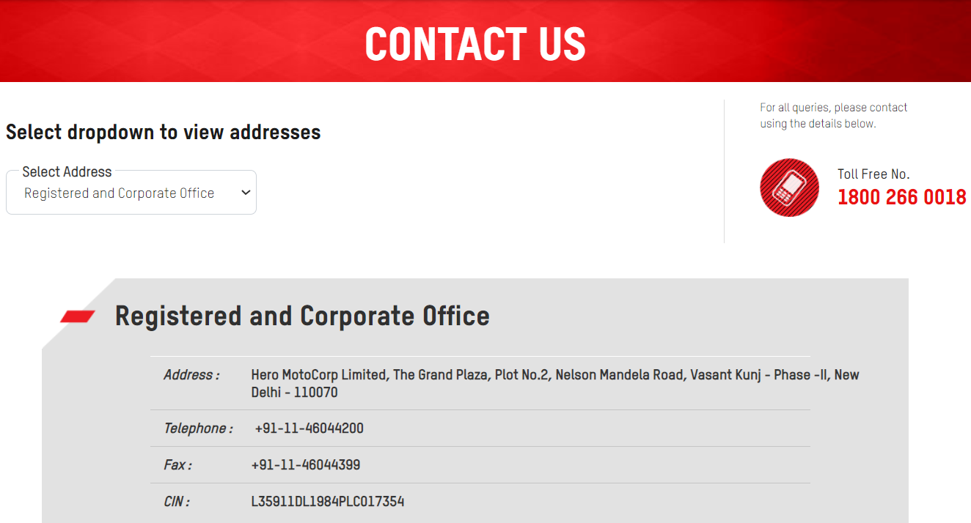
Content Creation & Curation
EMAIL AD CAMPAIGNS :

Slide 52
Content Creation & Curation
EMAIL AD CAMPAIGNS :

Slide 53
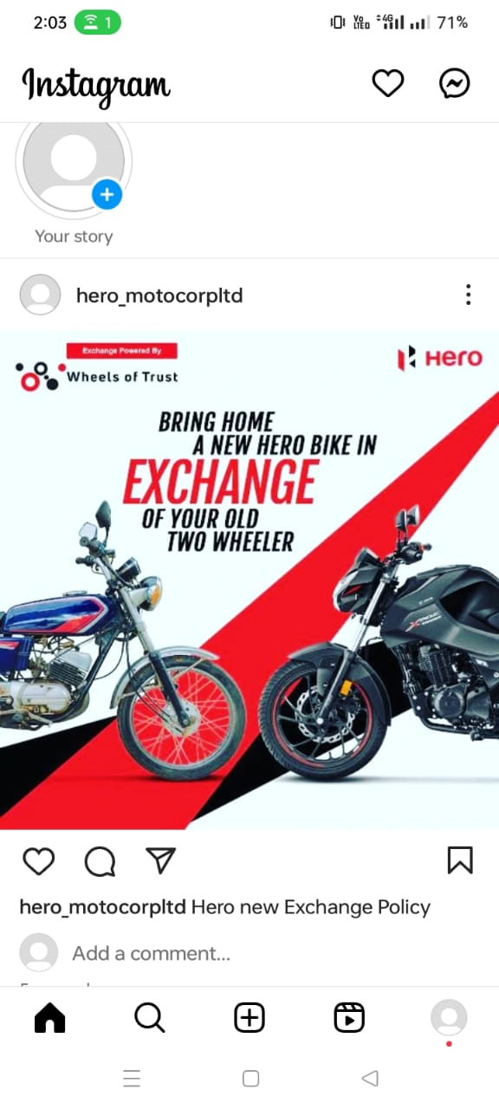
Content Creation & Curation
Instagram Post Creation :
https://www.instagram.com/p/CyVOjnuSbU8/?igshid=MWZjMTM2ODFkZg==

Slide 54
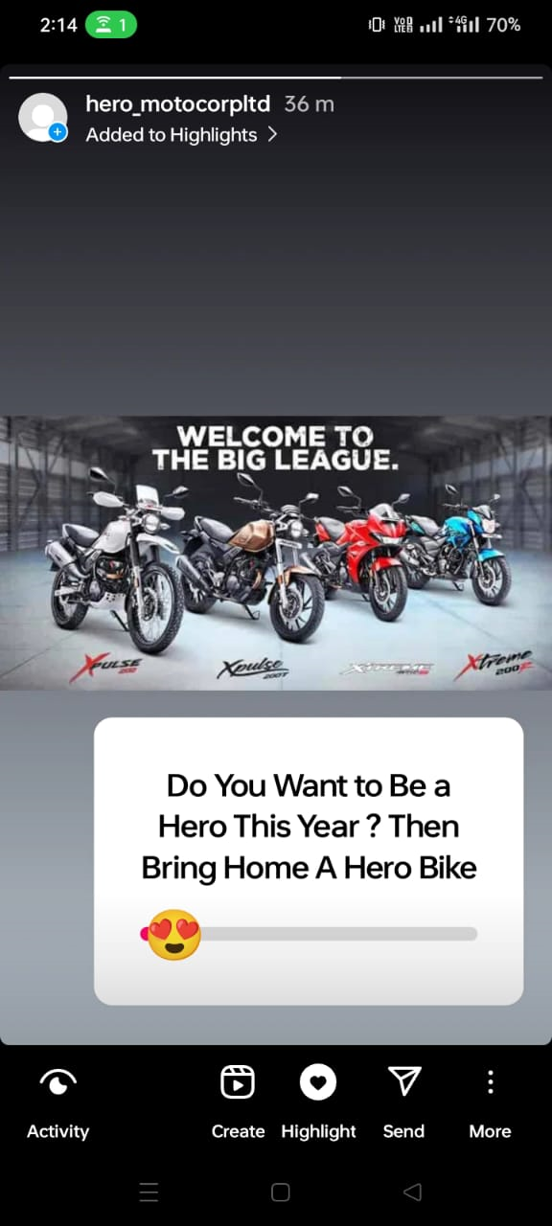
Content Creation & Curation
Instagram Story :
https://instagram.com/stories/hero_motocorpltd/3212539093125274564?utm_source=ig_story_item_share&igshid=NmQ4MjZlMjE5YQ==

Slide 55
Lessons Learned :
Consistency is Key: Consistency in content creation helps to establish brand recognition and build a loyal audience. Maintaining a consistent brand voice, visual identity, and posting schedule creates a cohesive brand experience for the audience.
Quality Over Quantity: While it's important to consistently create content, focusing on quality should take precedence over quantity. Well-produced and thoughtful content tends to have a more significant impact and can lead to higher engagement and brand loyalty.
Building Relationships and Collaborations: Collaboration with influencers, partners, or customers can provide fresh perspectives and expand the reach of the brand's content. Collaborations help tap into new audiences, bring in diverse ideas, and create engaging content.

